Slide 1
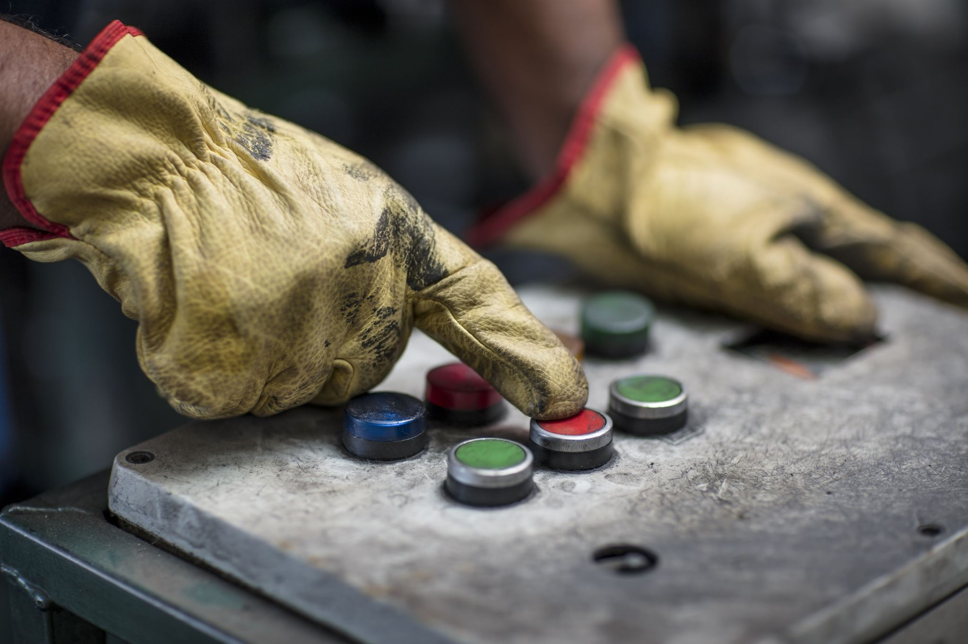

Evaluating Production Bottlenecks Through Downtime Analysis (March- august, 2025)
BY: OLUWATOSIN ADENIRAN

Slide 2
EXECUTIVE SUMMARY
645 Batches processed
363 Delayed Batches
885 Downtime Factors
21.74 Days Lost
13 Distinct Factors
Max 4 Downtimes per Batch

Slide 3
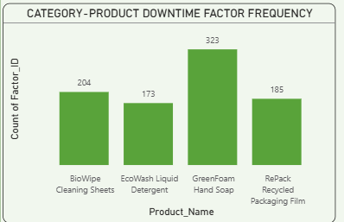
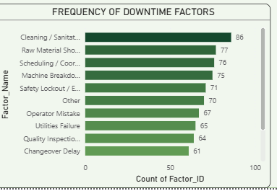
DOWNTIME FACTOR OVERVIEW INSIGHTS
GREENFOAM HANDSOAP showed the highest number of factors (323) recorded.
The top 3 factors causing these downtimes are:
Cleaning
Raw materials shortage
Scheduling/ Coordination Delay

Slide 4
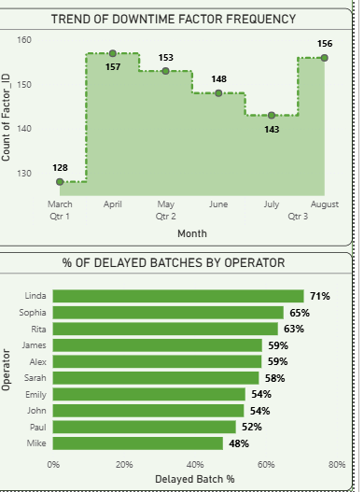
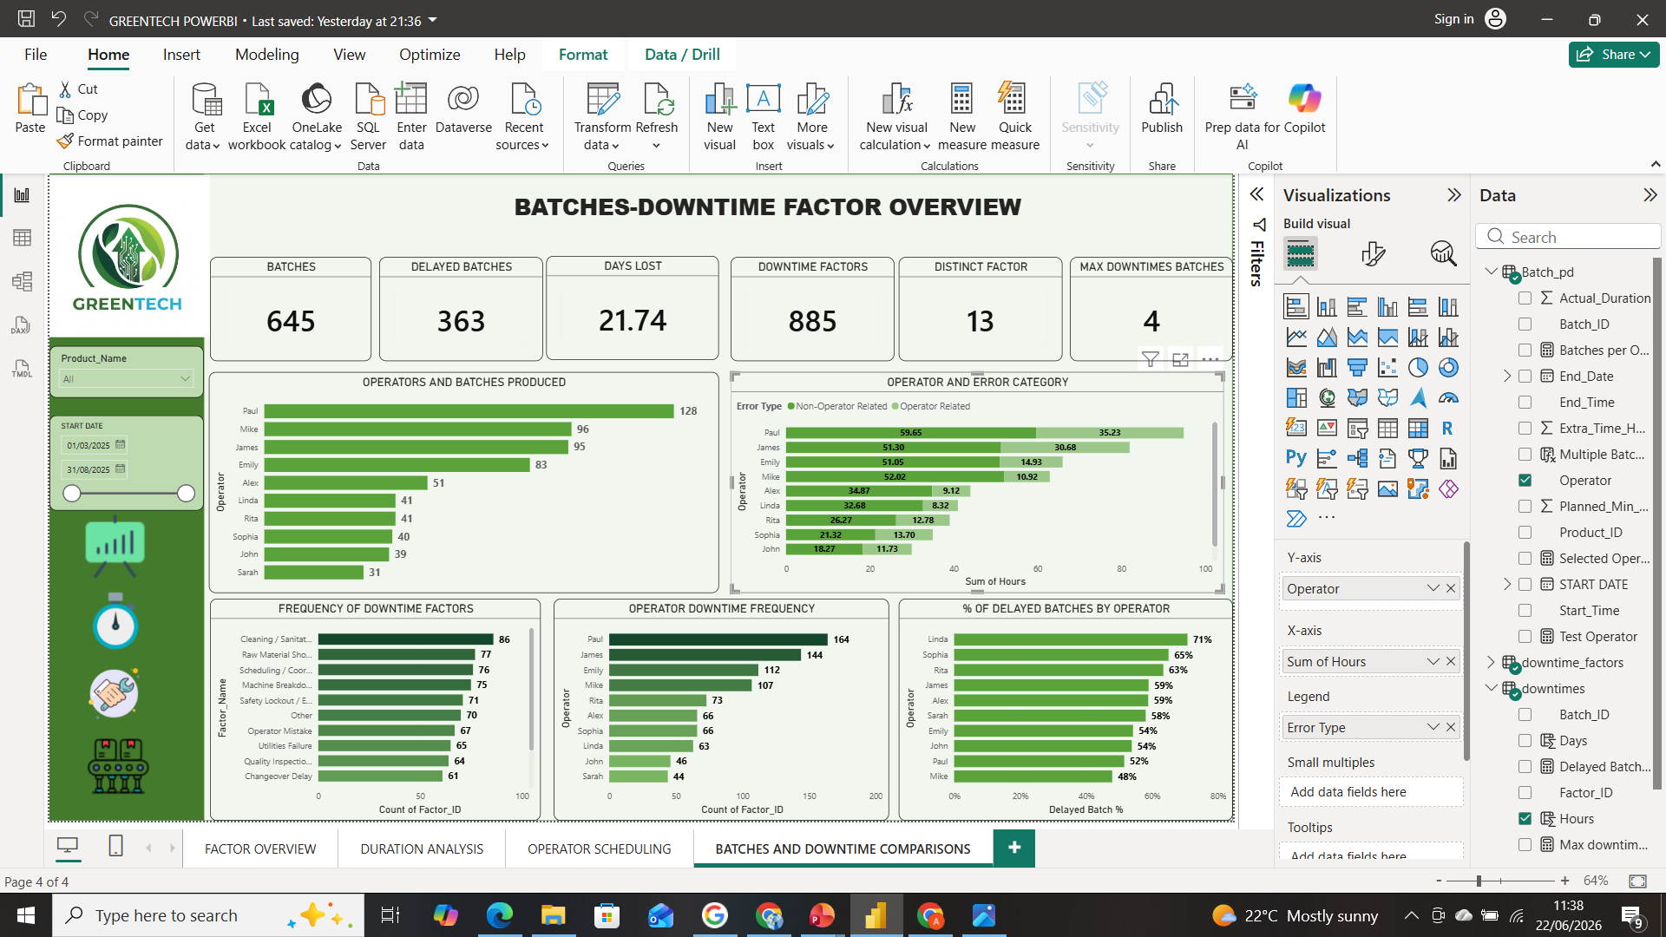
FACTOR OVERVIEW CONTD
Linda had 71% batch delay in the 41 batches produced, which accounts for about 29 of the 41 batches

Slide 5
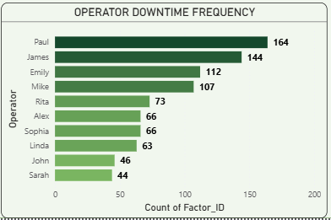
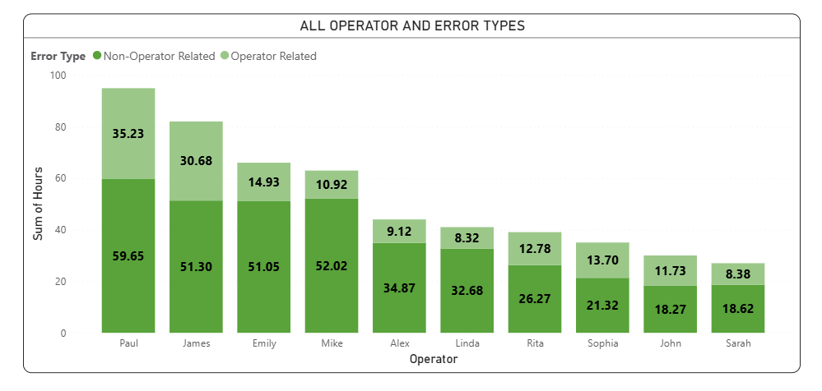
FACTOR OVERVIEW CONTD
Paul recorded the highest number of downtime events (164) across 128 delayed batches, averaging 1.28 downtime events per delayed batch.
James recorded fewer downtime events (144) but across only 95 delayed batches, averaging 1.52 downtime events per delayed batch.

Slide 6
Keynotes of Factor Overview
Paul recorded the highest downtime frequency (164 events across 128 batches).
James recorded 144 downtime events across 95 batches, indicating higher downtime intensity per delayed batch.
Linda, Sophia, and Rita had the highest percentage of delayed batches, suggesting a greater proportion of their assigned batches experienced delays.

Slide 7
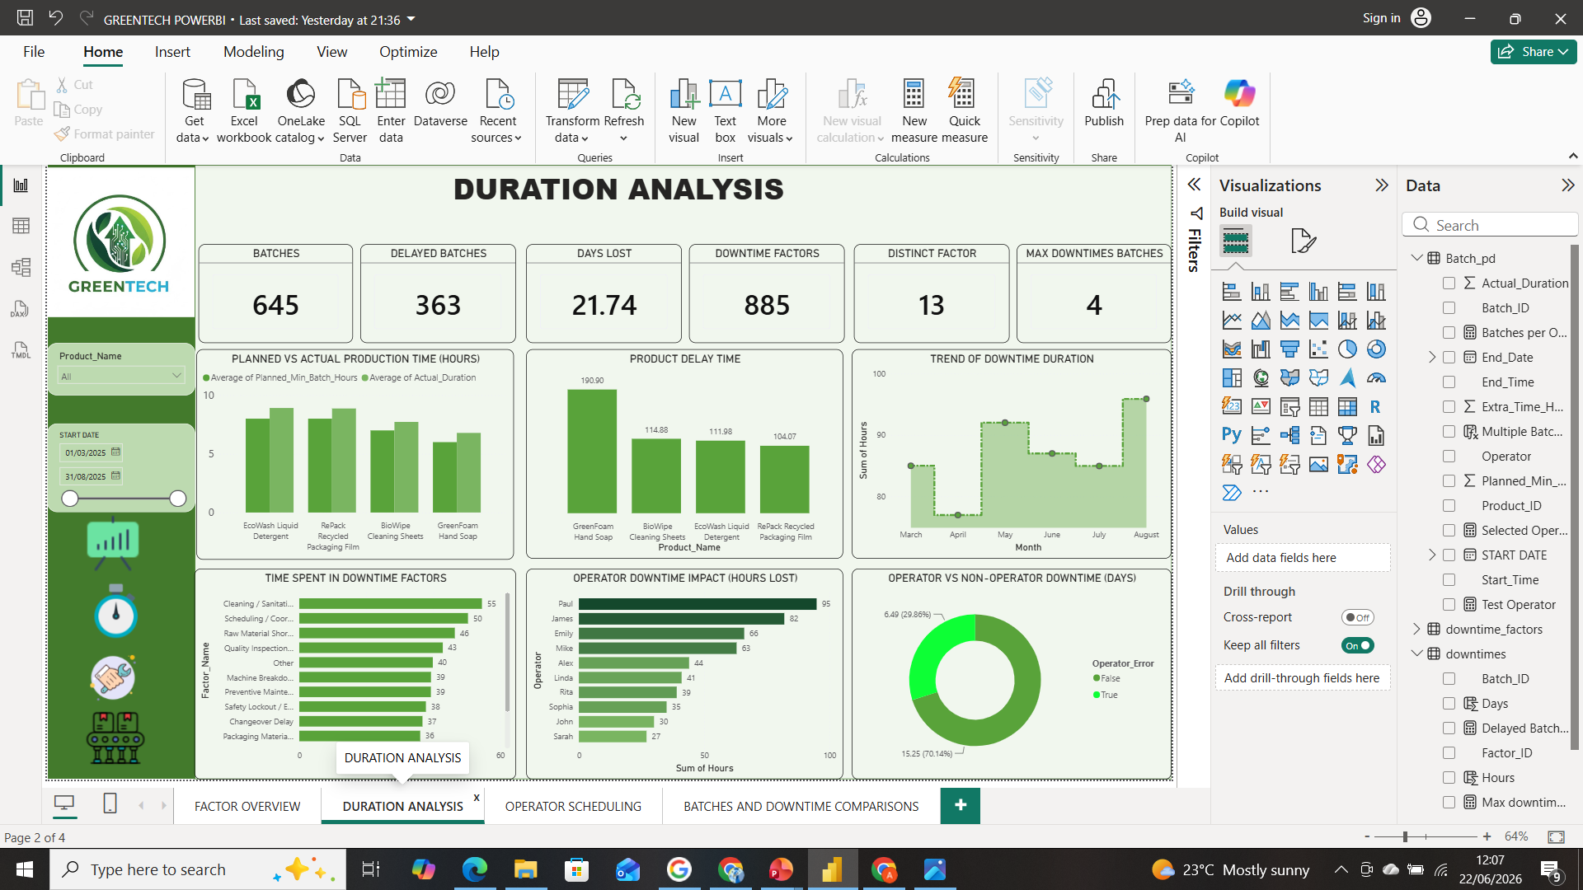
DOWNTIME DURATION
GreenFoam recorded 190.9 hours of delay time, which is significantly higher than the rest.
Downtime duration peaked in August (~96 hours).
July and March were also relatively high. April recorded the lowest downtime duration.
Business Impact
Increased production costs
Reduced throughput
Higher risk of delayed customer orders

Slide 8

DOWNTIME DURATION CONTD
Cleaning and sanitation incurred more production time compared to equipment failures, which shows that process efficiency was the primary cause of the downtime compared to equipment reliability.
Nearly 100 hours of downtime are linked to planning and supply-chain-related issues rather than production equipment failures.

Slide 9
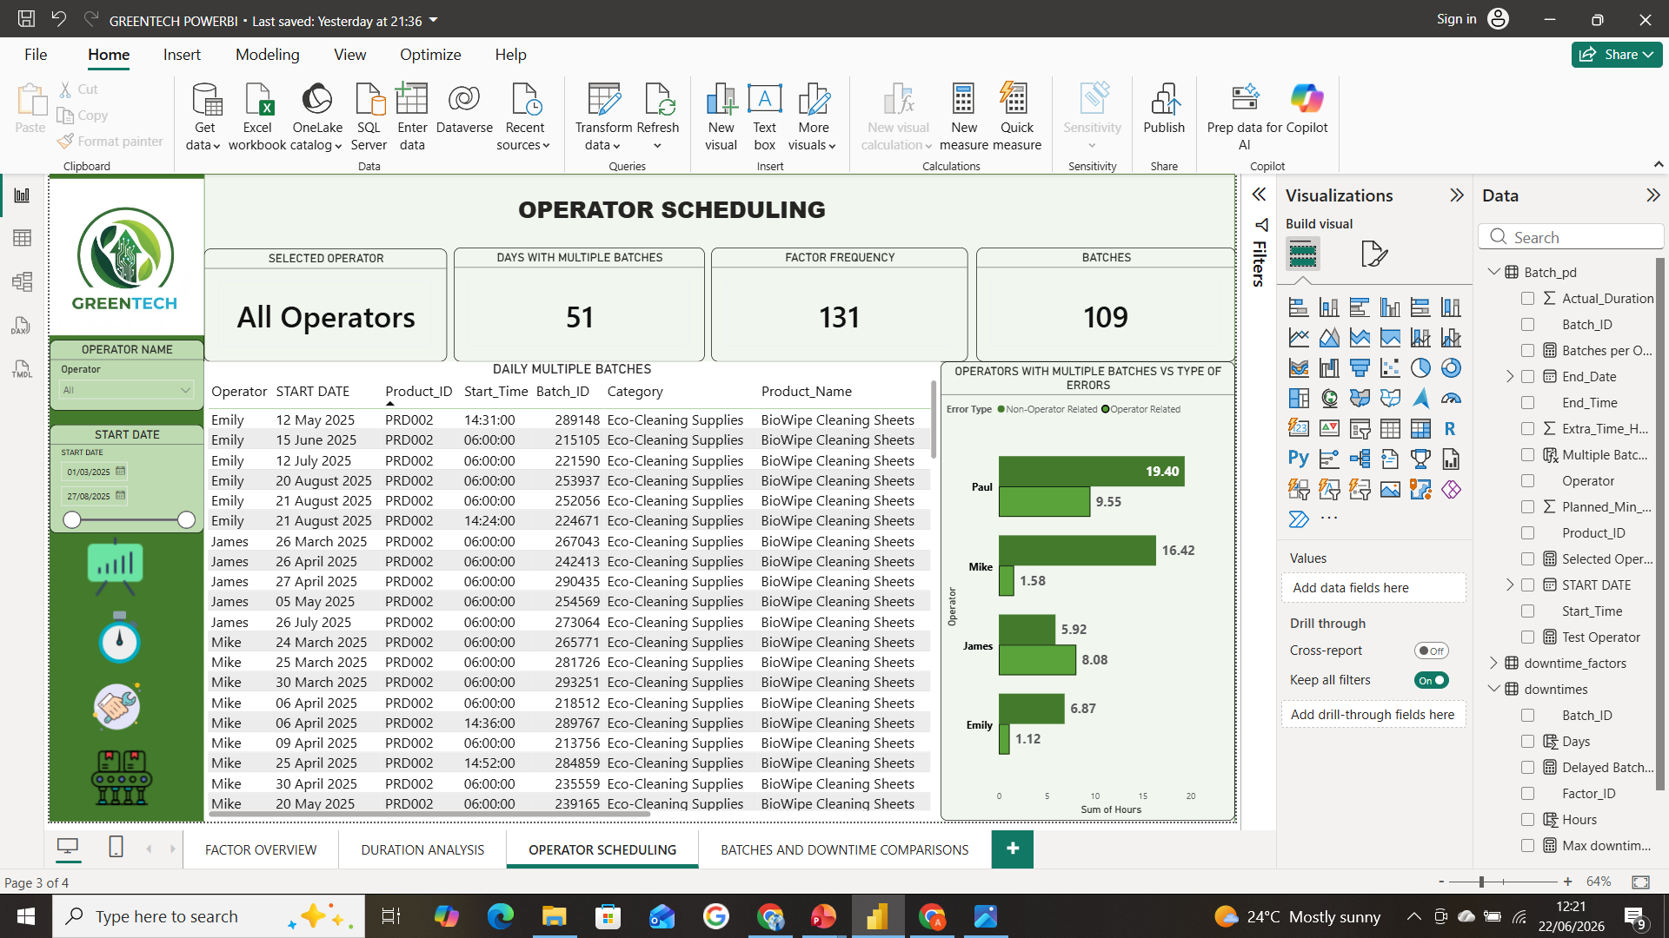
OPERATION SCHEDULING
It was noticed that 4 operators- Paul, James, Emily and Mike, had multiple batches running simultaneously which could lead to downtimes and batch errors.
51 Multiple batch days, 131 factors and 109 batches.

Slide 10
OPERATION SCHEDULING CONTD
During multiple-batch operations, 109 batches were processed and 131 downtime events were recorded.
This indicates that batches handled under higher workload conditions experienced an average of 1.2 downtime incidents per batch, suggesting that multiple-batch scheduling may increase operational complexity and the likelihood of production disruptions.
Metric | Overall | Multiple-Batch Days
Downtime Events | 885 | 131
Batches | 645 | 109
Events per Batch | 1.37 | 1.20

Slide 11
CAUSES OF DOWNTIMES
Primary Downtime Causes
Cleaning / Sanitation Cycle
Scheduling / Coordination Delays
Raw Material Shortages
Quality Inspection Holds
Machine Breakdowns
Secondary Downtime Causes
Preventive Maintenance activities.
Safety Lockout / Emergency Stops.
Changeover Delays between products.
Packaging Material Defects.

Slide 12
Recommendation for Downtime impact areas
Operational Inefficiency:
Reduce major downtime drivers such as Cleaning/Sanitation and Scheduling Delays through process optimization.
Implement preventive maintenance and operator training to minimize avoidable production interruptions.
Financial Costs($1.5 million loss annually):
Focus improvement initiatives on high-impact products such as GreenFoam Hand Soap to reduce revenue losses.
Monitor downtime costs by product, factor, and operator to prioritize corrective actions.

Slide 13
Recommendation for Downtime impact areas CONTD
Customer Delays:
Improve production planning and coordination to reduce delayed batches and missed delivery deadlines.
Establish early warning alerts for production bottlenecks affecting customer orders.
Resource Wastage:
Improve inventory forecasting to prevent raw material shortages and excess stock.
Implement inventory control measures with defined reorder levels for critical materials.

Slide 14
Expected Impact
Reduced downtime, lower operational costs, and improved production efficiency.
Increased on-time delivery performance and enhanced customer satisfaction.

Slide 15
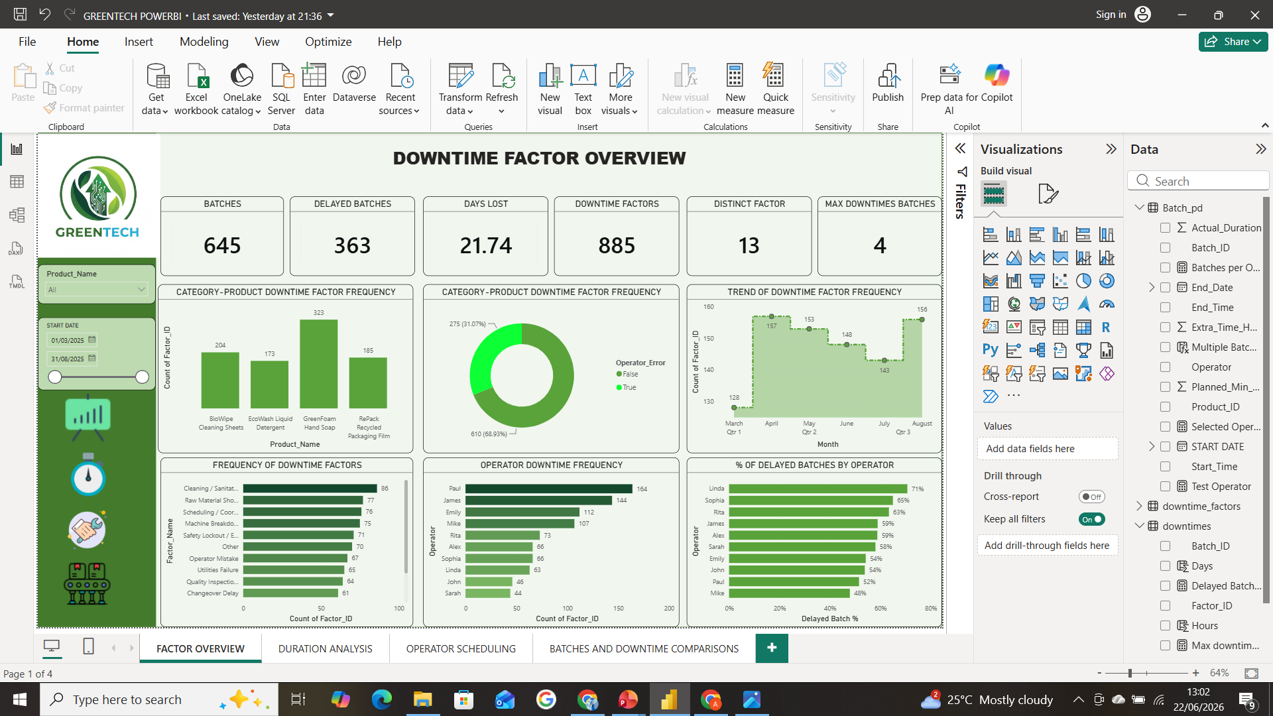

Slide 19
THANK YOU FOR LISTENING

